Slide 1
Getting Started with Linux
Please come in and sit anywhere you like!
Mint v. 17
Note: If you're adopting a Free Geek computer today, please sit at an open table (not a computer terminal).

Slide 2
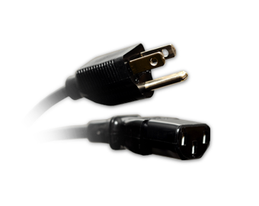
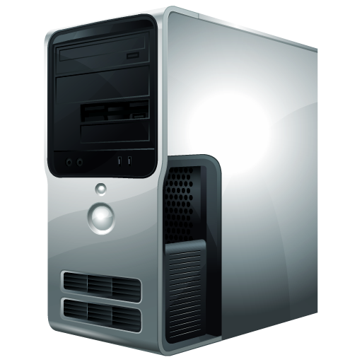
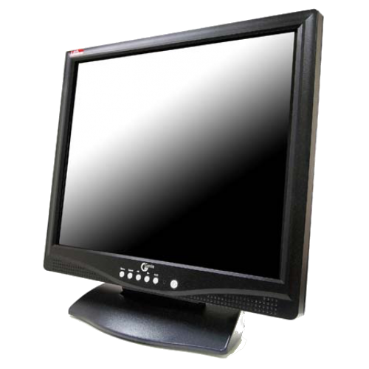
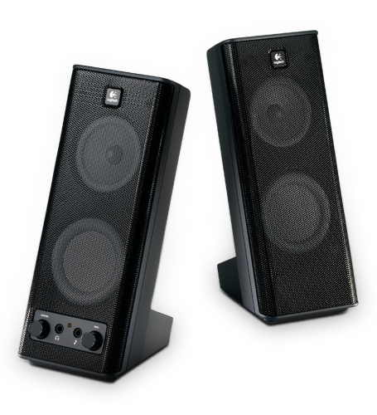
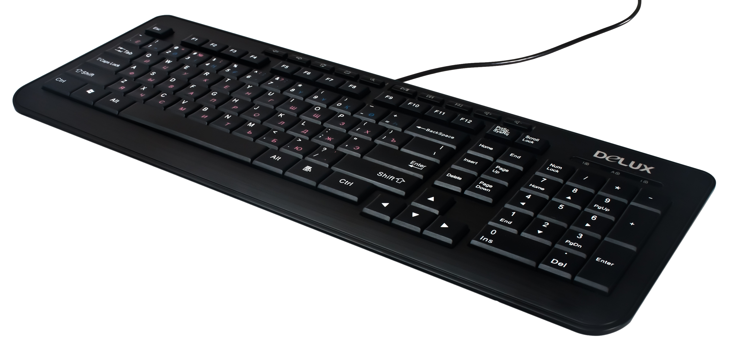
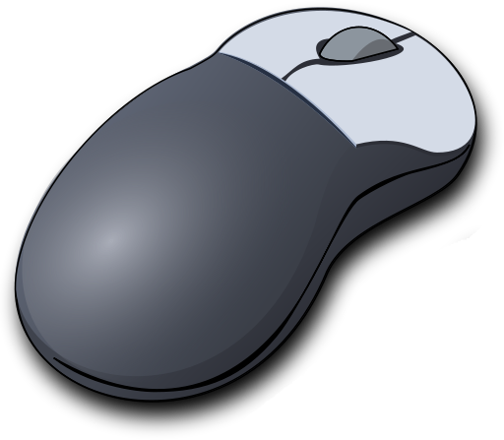
Assemble your new FreekBox!
*ask your instructor if you need help

Slide 3

Introductions

Slide 4
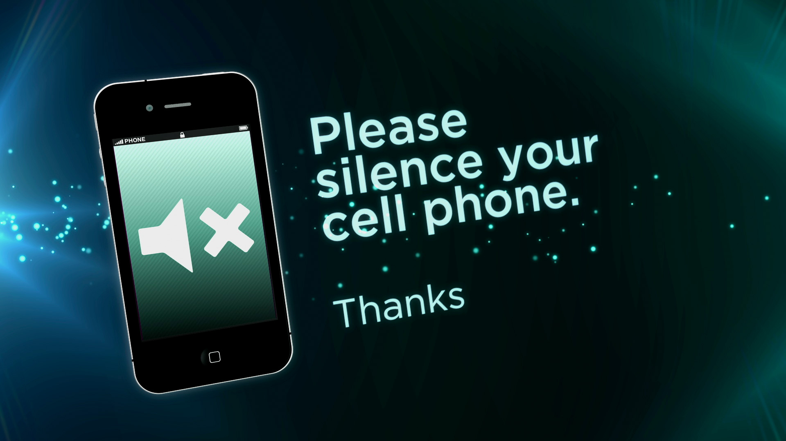


Slide 5
The purpose of this class is to:
Make sure all of your hardware and software are working correctly.
Give you a hands-on introduction to the Linux operating system.
Set up your system the way you like it.
Introduce you to the concept of Open Source.
...and, just for attending our class today, you gain access to a full year of free tech support offered through Free Geek!

Slide 6
Today's Agenda:
Vocabulary
Linux History/FOSS
Assemble your system
Log in
Test sound and video
Proprietary Software
Updates
BREAK
Tour your Desktop
Install Programs
How to Find Help
Q&A Time
Paperwork
Questions about Tech Support
Take your computer home!

Slide 7


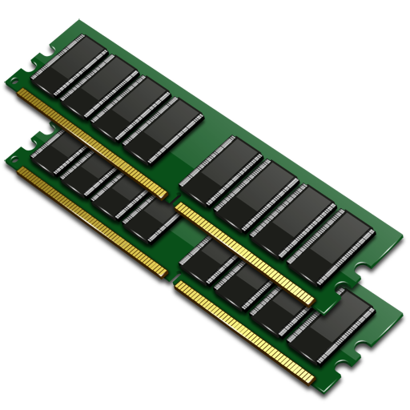
Vocabulary
Hardware – It's the parts of the computer you can touch: monitors, keyboards, mice, and so on... even the parts on the inside of the box are considered hardware.
Software – Conversely, software are programs on your computer you cannot touch, such as your operating system, your web browser, Skype, and so on...

Slide 8
Vocabulary
Monitor – this is the screen for your computer. It doesn't have any computer parts in it: it's just the screen.
Computer/CPU – This is the box that houses all the circuit boards, the hard drive, motherboard, RAM, and more. It's sometimes called a desktop.

Slide 9
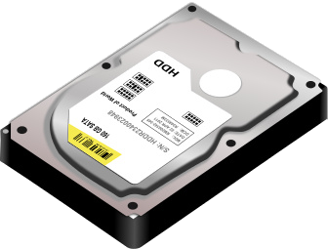
Vocabulary
Hard Drive – This is where all of your pictures, games, movies and documents are saved on your computer. It's a small array of metal disks inside a hard case. When you turn off your computer, everything on the hard drive stays there.
Memory (also called RAM) – These are small rectangular chips that slot into the motherboard. They handle short-term calculations. None of your important documents are saved on your memory (I know that sounds counter-intuitive...)

Slide 10
Vocabulary
Internet – It's a bit difficult to explain the Internet in a few sentences, but it's basically a constant conversation between millions of computers around the world simultaneously. You can plug into that conversation by going online.
Web Browser – How do you access the Internet? By using a web browser. A web browser is a program on your computer that helps you navigate the Internet. Popular programs are Firefox, Chrome, Safari, Internet Explorer, and so on...
Search Engine – A search engine is a tool that helps you find things on the Internet. It's sort of like a Yellow Pages for the Internet. Popular search engines include Google and Yahoo. This is not a program on your computer: it lives entirely on the Internet.

Slide 11
Using the mouse:
Left click:
Most of your work will be done with this button. Clicking once will select a program/folder. Clicking twice will open a folder or run a program.
The right mouse button is for options. When something is selected, you can press the right mouse button to change the selected thing.
Scroll wheel:
Push forward or backward to move a page up or down (when applicable).

Slide 12
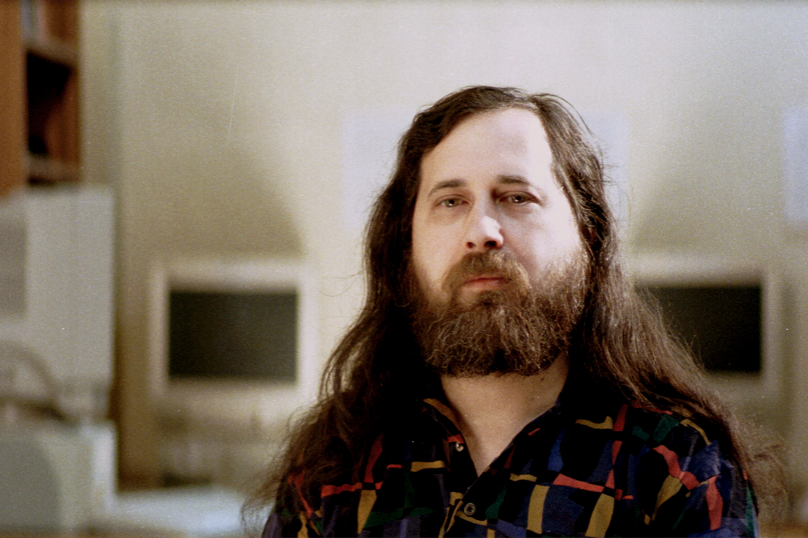

A Brief History of Linux
In 1969, AT&T was required by law to release to the public the source code to their in-house operating system called UNIX.
In the 1980s, an MIT student named Richard Stallman started a program called the GNU Project. He and other software engineers studied the UNIX source code, and starting creating a free UNIX-like software collection. Anything made by GNU was given away for free!
The GNU Project believes in the freedom to use, share, and modify software without needing to pay fees, royalties, or worry about violating intellectual properties.
Notes:
In order to relate what happened, here's a useful metaphor:
Think of these things in terms of car parts – in 1969, AT&T was required to release the blueprints for their state-of-the-art car to anyone who asked. You could study them, but could not reproduce the car exactly as it was (or be hit with a lawsuit). Instead, the GNU Project used the engine of the car and built accessories that ran off of the engine, but did other things (the User Land). They weren't violating any laws because they weren't actually building a car.
The difference here is that, while car parts are expensive, heavy and hard to make, software is easy to reproduce, inexpensive and weighs nothing at all! So they could be reproduced and distributed over and over and over. Eventually they nearly built their very own car that looked nothing like AT&T one at all! See next page for LINUX details.

Slide 13
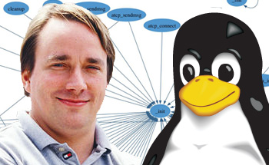

A Brief History of Linux
In 1991, a Finnish software engineer named Linus Torvalds built a whole kernel – then plugged it into the already establishd work that GNU Project made – and voila! – LINUX was born!
Linux and the GNU Project are designed with the philosophy that software should be free for everyone to use, share, and upgrade, so that computers and technology are accessible and easy-to-use for anyone and everyone!
Notes:
Continuing the car metaphor. Years later, after GNU Projects software had permeated the programming world, Linus Torvalds decided that he would reverse engineer what GNU worked on – he took the chassis and built his very own engine!
As you can imagine, in order to work with ALL the GNU Project stuff, it needed to function A LOT like UNIX, and indeed it did. Fortunately, because it was written by Linus himself, it did not violate any IP rights that AT&T help.
And so, almost 30 years later, a fully-fledged free version of a car was born – called LINUX!

Slide 14

Why use Linux?
No licensing fees!
No viruses!
Philosophy of mutual aid and openness.
Great for people who want to get into the 'guts' of the system.
Notes:
Technically, there are viruses for Linux, but they're very difficult to get because the security structure for Linux is much stronger than that of Windows (it's similar to Mac in that way, because both are descendants of the UNIX OS)
Additionally, it's very unlikely that a hacker would write a code specifically to target Linux systems, because (at the moment) most people who use Linux are programmers by trade or hobby, and can easily target and remove harmful programs.
Still, advise your students to always be careful online and never input sensitive information if you're not absolutely sure that it can't be intercepted.

Slide 15
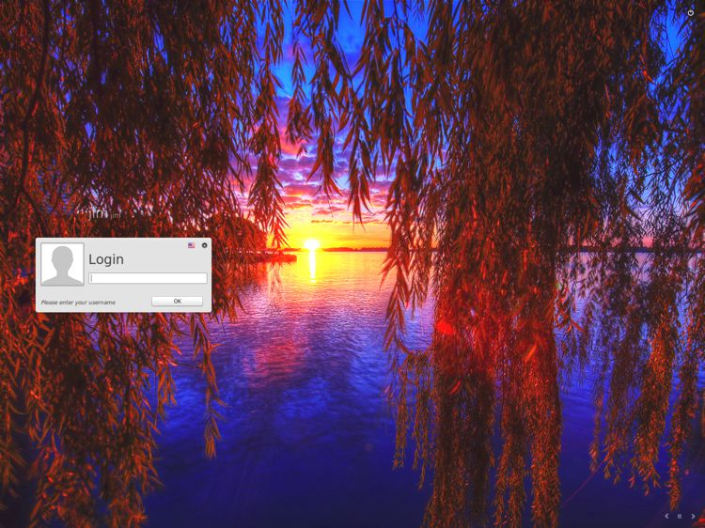
LOGIN: oem
PASSWORD: freegeek

Slide 16
Desktop image for OEM computer.

Slide 17
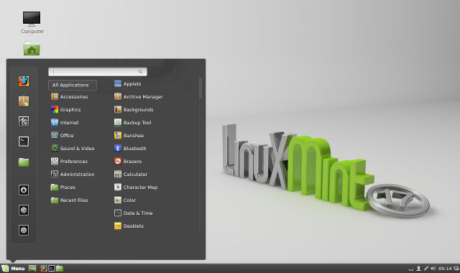
The Desktop

Slide 18
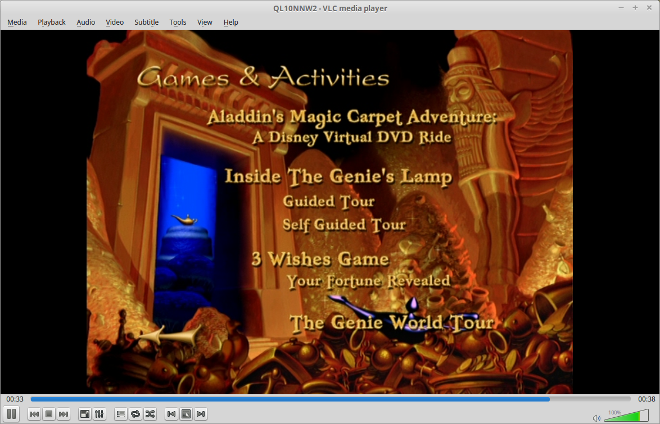
Check Audio and Video
Get a DVD from an instructor.
Insert disk into the disc tray
Banshee/VLC should start automatically
  If nothing happens, ask instructor.
Notes:
Can simply be DVD, no need to check for Audio only.

Slide 19


Preparing your computer for home use...
Open Menu:
Go up to Adminstration
Click 'Prepare for shipping to end user'
Enter 'freegeek' password
'OEM will run the next time the system starts:' Click OK.
Click on Menu again
Click Shutdown
Click Restart
Notes:
Please add instructor's method of shipping to end user, if this process doesn't work correctly.

Slide 20
Setting up your own account
Select the language you want to use for your account.
Select your time zone
  It should default to Los Angeles. If not, check your internet connection.
Set the default language for your keyboard.
Choose a user name.
Choose a name for your computer.
Choose a password.
Confirm your password.
  Useful tips for password creation.
Notes:
Username MUST be lowercase.
Make sure the students remember their password, and write it down if necessary.

Slide 21
Updating your system
Because Linux is a community-driven project, people are always coming up with new ways to improve it. As they do, the Linux organizers collect and distribute the improvements to every user through the Update manager.
These updates can be minor fixes, compatability upgrades, or security improvements.
  Linux will never install viruses, third-party programs, malware, or anything like that through the Update manager. These programs are very thoroughly vetted.
Let's check to see if you are up-to-date.
  Click the Update Manager applet in the bottom right-hand side of your screen...

Slide 22
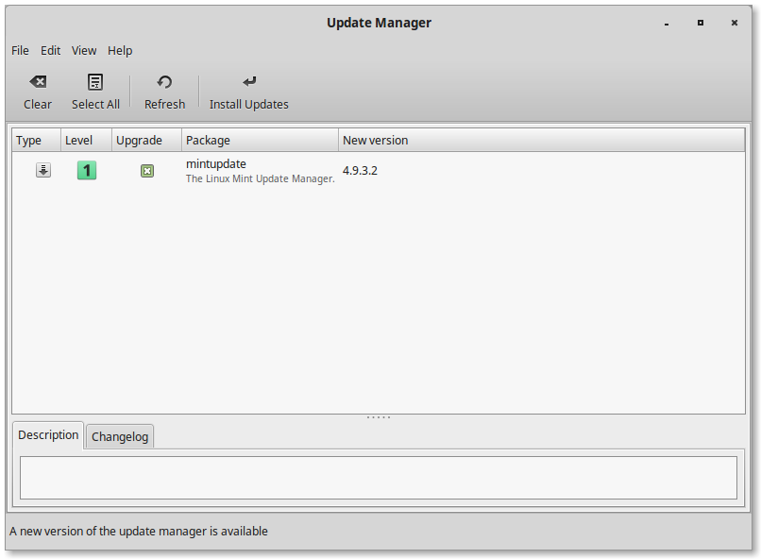
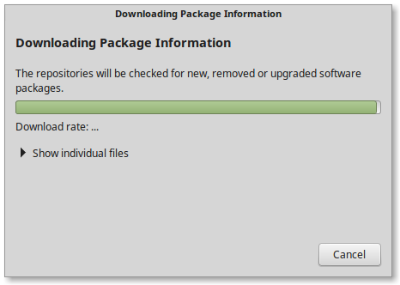

Slide 23
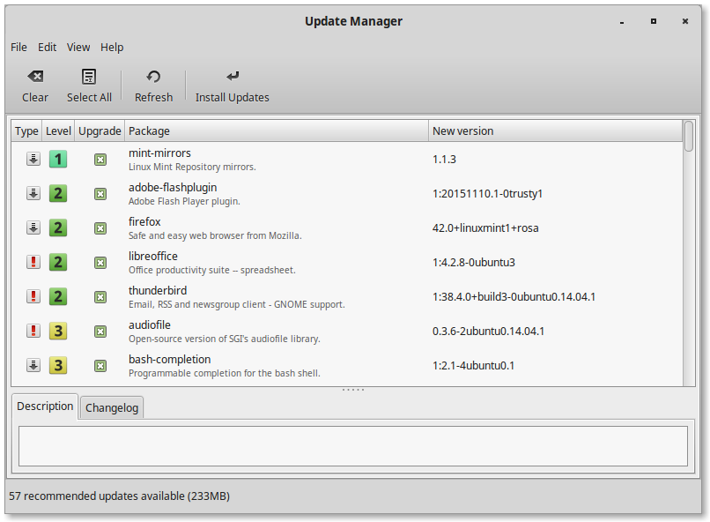
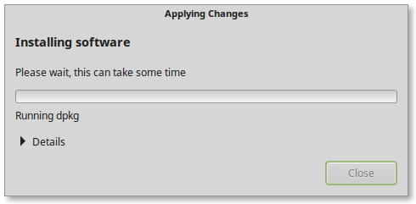

Slide 24


Slide 25
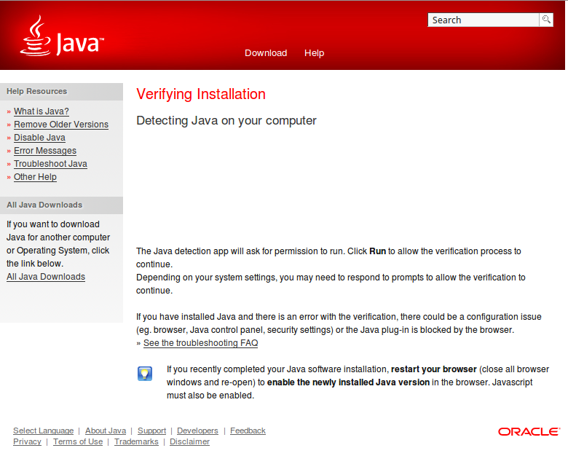
tinyurl.com/fgjava
Something should show up here explaining your current version of Java.

Slide 26
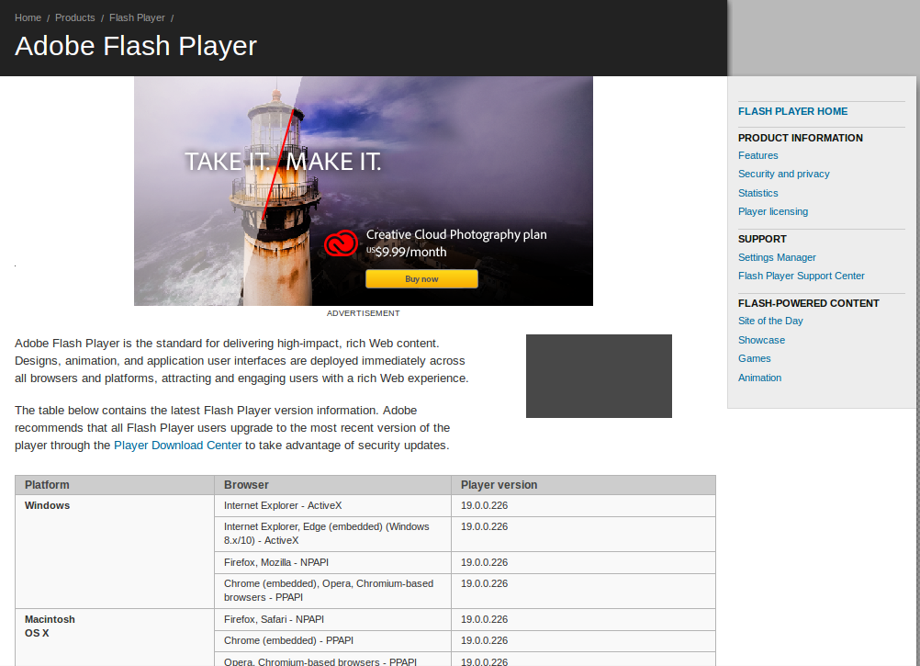
tinyurl.com/fgflash
Current Version shows HERE

Slide 27
Software Manager
Settings
Terminal
Lock Screen
Log Out
Shut Down
This long gray bar is called 'the Panel'
Menu
Launchers
Applets
Notes:
Set transitions so that each arrow shows up individually. Reduce business.

Slide 28
Let's look at our Applets...
Look at the bottom, right-hand corner of your screen.

Slide 29
Overview of the Panel Applets
Check for updates to your computer's programs and operating system.
List all the windows that are currenty open.
Adjust volume and sound settings
Immediately show your desktop.
Check Internet connections and options
Set date and time.
Check account details and shut down or switch users quickly.
You can find and add more applets!

Slide 30
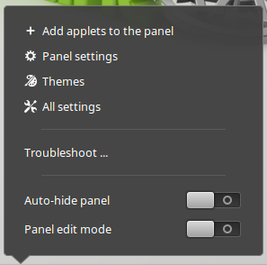
Let's add an Applet to your panel!
Right-click on the panel
Click 'Add applets to the panel.'

Slide 31
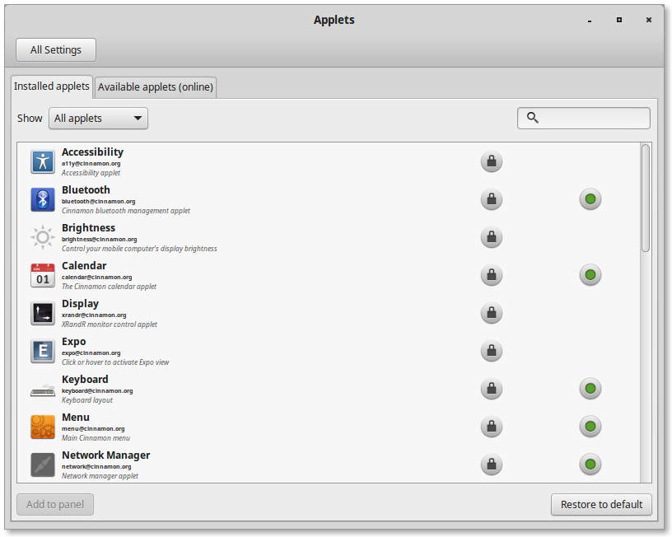
Click on Available Applets (online)

Slide 32
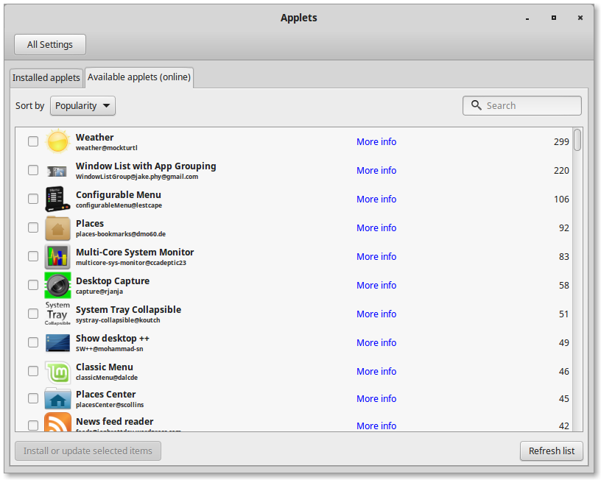
Make a check in the checkbox next to the 'Desktop Capture' applet.

Slide 33
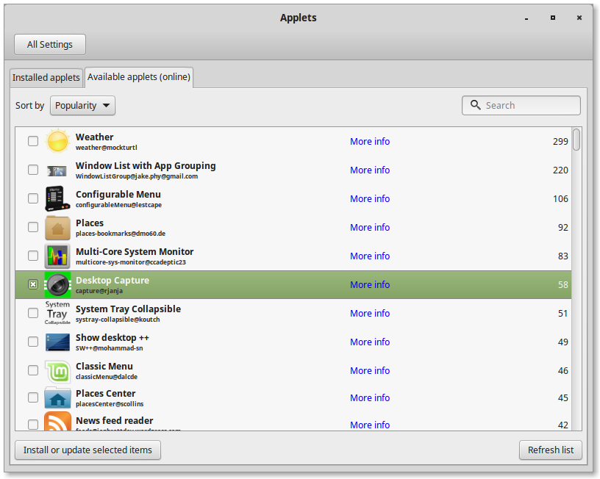
Click Install or Update selected items.
Go back to 'Installed Applets

Slide 34
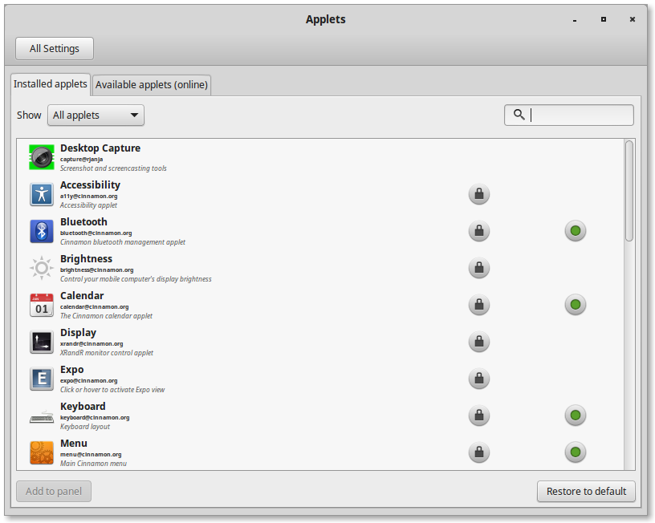
Desktop Capture should be here.
Right-click it and then click 'Add to Panel'
You can also Right-click it to remove it from the Panel later, or even uninstall it.

Slide 35
More about the Panel...
Here you can:
  Put more applets on the panel.
  Get to the panel options.
  Change the style and color of your desktop.
  Or, access general settings for all of your computer's programs.
Toggles:
  Auto-hide panel makes your panel disappear, and it will only peek out if you move your mouse to the bottom of the screen.
  Panel edit mode will lock or unlock your panel for editing.
  They are set to OFF as a default.
Notes:
Not a necessary part of the class. This is more useful for reference on the website.

Slide 36
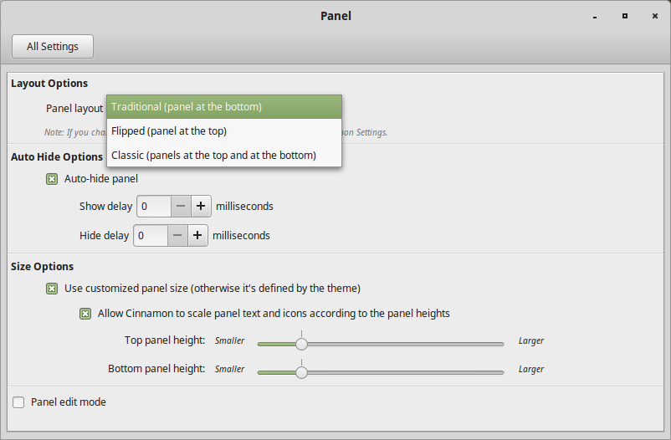
Panel Settings
Here, you can change the location of your panel!
Here, you can set a delay for your panel, if you like...
Here, you can set how big or small you want your panel to be...
Notes:
Not a necessary part of the class. This is more useful for reference on the website.

Slide 37
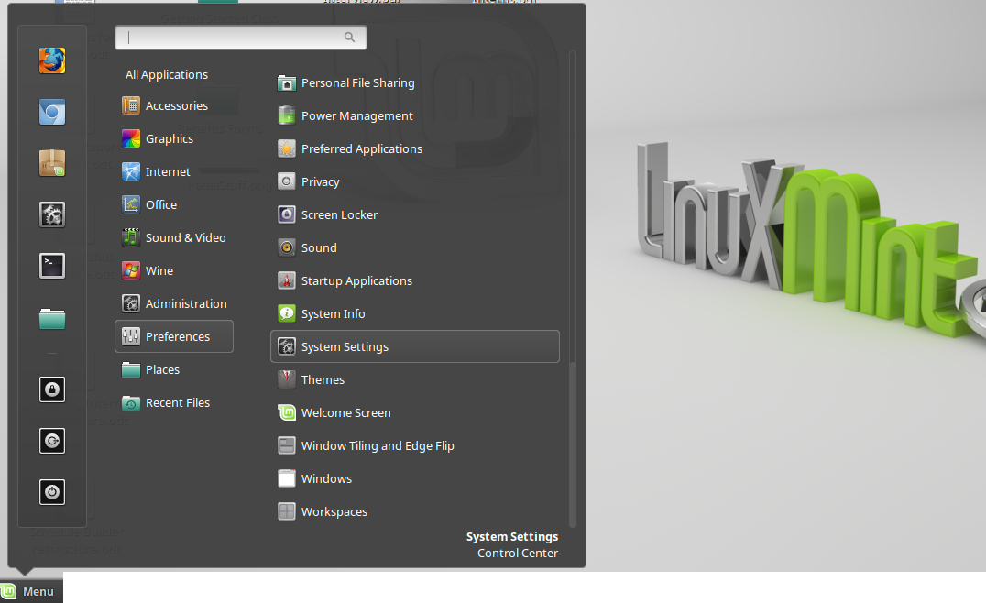
Let's check out System Settings...
3. System Settings also lives under Preferences>SystemSettings
Tooltip:
Whenever you hover over an item in the menu, the tooltip will show up and tell you a little about it.
2. Hover over System Settings
1. Click on Menu

Slide 38
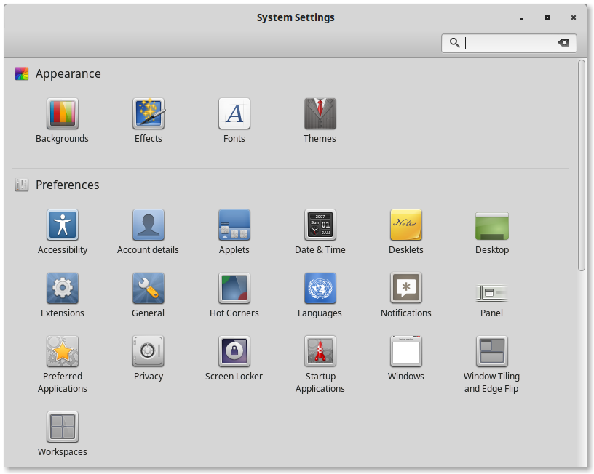
First, lets give your desktop a new background!

Slide 39
Let's go online to find a good background image!
Click on the Mozilla Firefox Icon
You can also just click once on the Firefox launcher near the Menu.
Click on 'Menu'

Slide 40
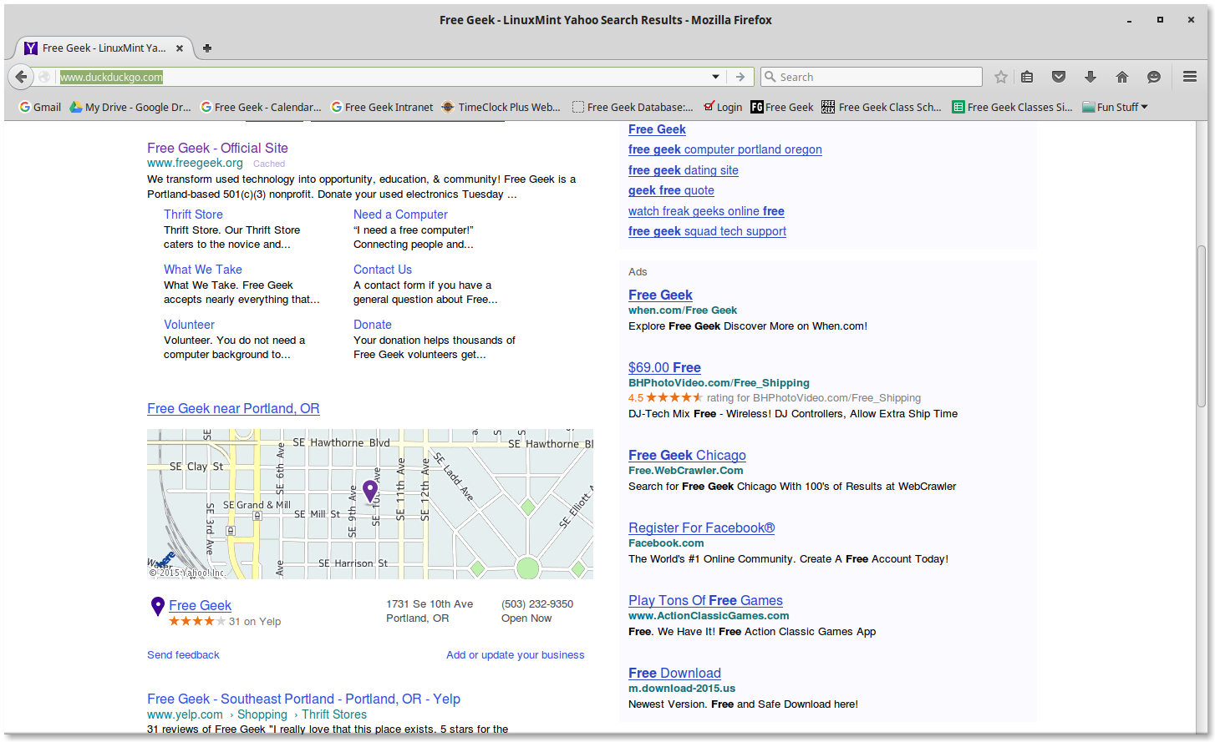
In the address bar, type in “www.duckduckgo.com” and press Enter
If there is any text there already, you need to delete it first.
Drag-and-drop your mouse cursor over the text (so that it highlights in green) and press 'Backspace'
(p.s) You can use www.google.com if you like...

Slide 41
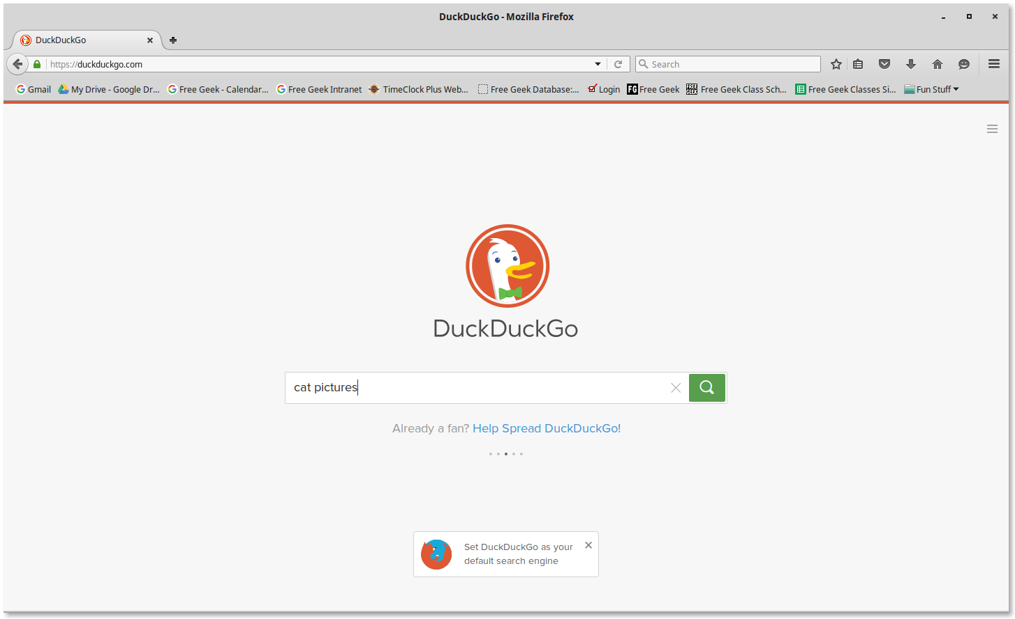
In the search bar, type in a category for a picture you'd like to use for your desktop background
Then press Enter.

Slide 42
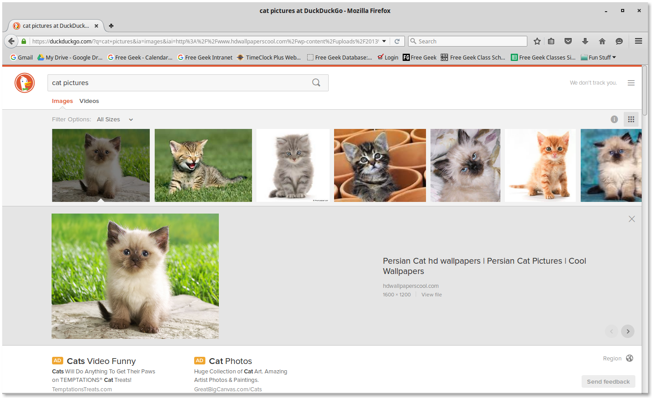
Now just find the picture that you like most...
When you click a picture, look at the dimensions. (width x height)
The larger the number
The better the picture will
look as your background.

Slide 43
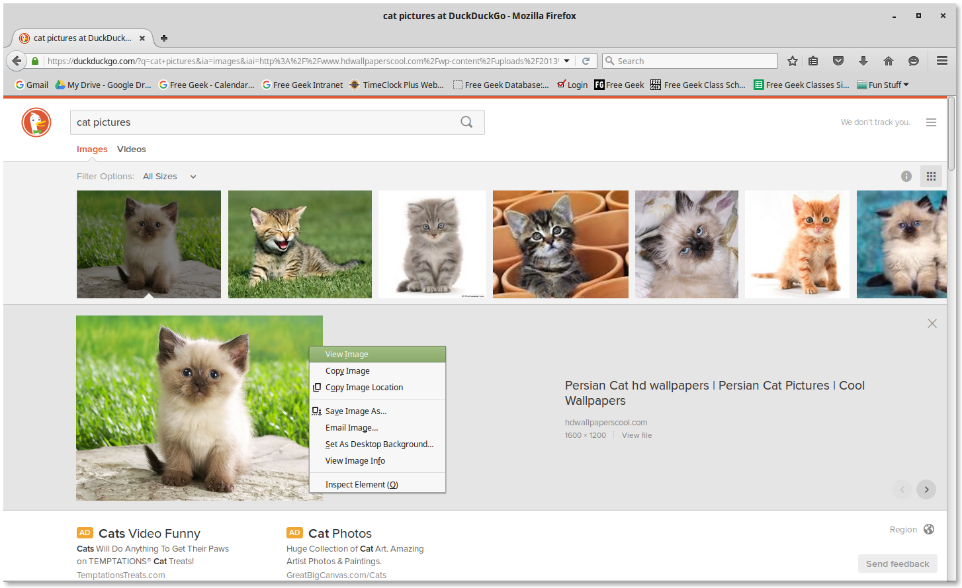
Right click the picture...
Click 'View Image'
This will show us the full-sized
image, not the scaled-down one.

Slide 44
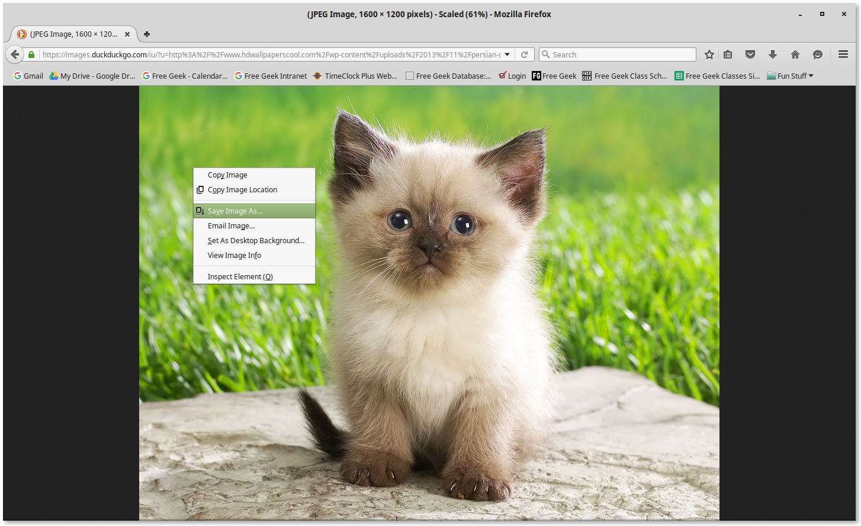
Now, right click the image again...
Now, minimize your web browser!
This time, choose
'Set As Desktop Background'

Slide 45
Let's go back to System Settings...
2. Click on System Settings
1. Click on Menu

Slide 46
Next, let's check out how to change your date & time settings...

Slide 47
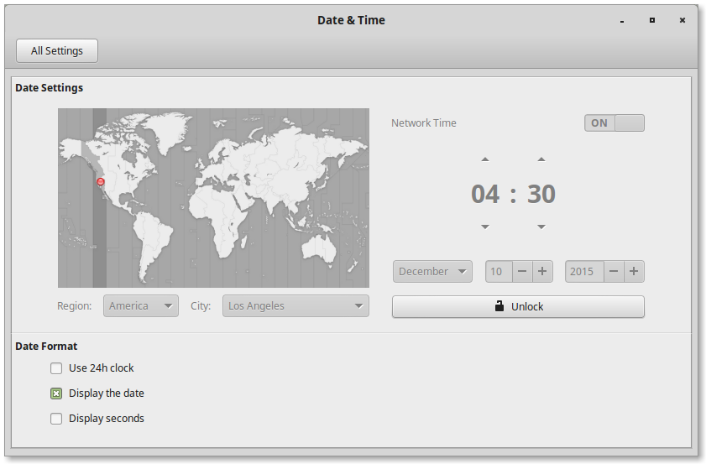
If you need to change your time settings, you need to unlock them first.
Click on Unlock, and enter your password.
Here, you can set your time to mililtary time,
or have it show the date,
or have it display the second clock as well.
Just check the box next to the option you want.

Slide 48
Now, let's download a
Desklet...

Slide 49
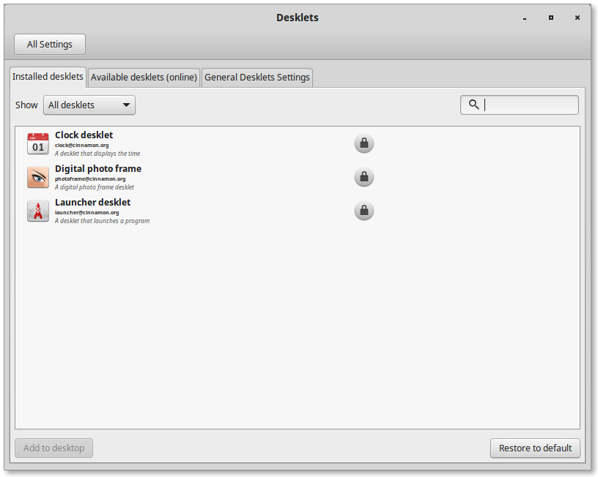
First, select the Available desklets (online) option
and let the repository update.

Slide 50
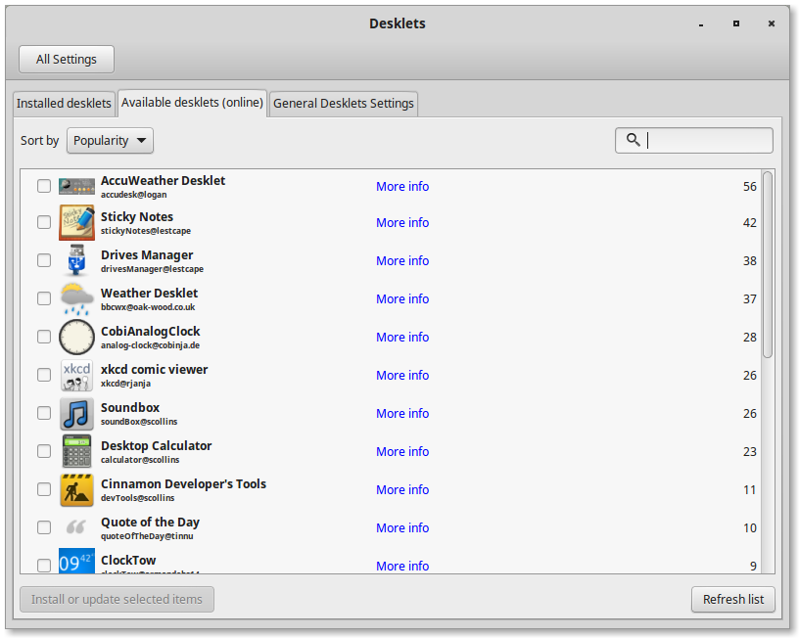
Let's install a weather desklet.
Choose the Weather Desklet by placing a checkmark in the box to the left of it.

Slide 51
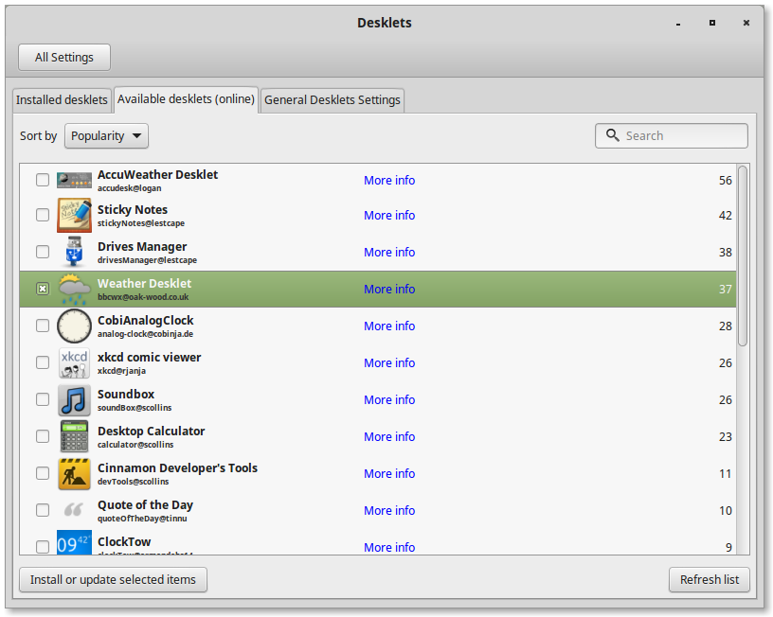
Now, return to 'Installed desklets.'
Click 'Install or update selected items.'

Slide 52
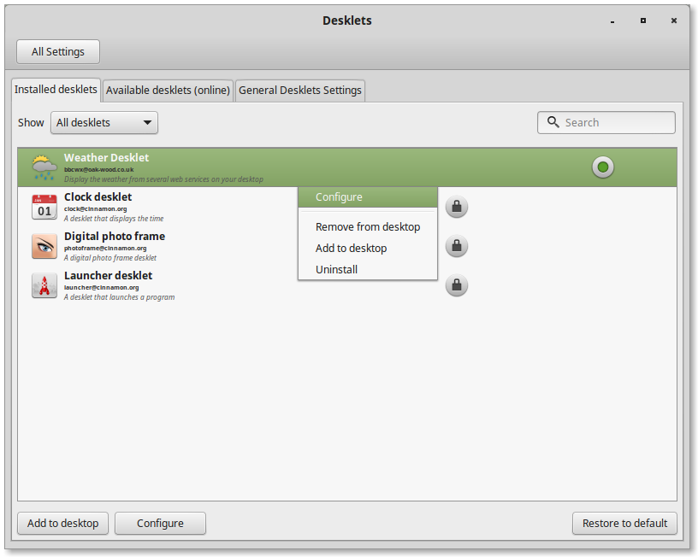
It's installed! Now let's configure it for Portland weather.
Right-click on the Weather Desklet.
Click on Configure.

Slide 53
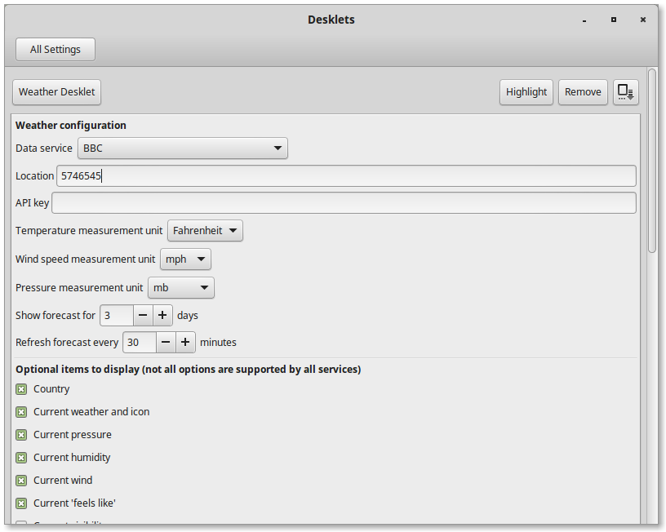
Select 'BBC' for Data service.
Under Location, type in 5746545
Click 'Weather Desklet' again.

Slide 54
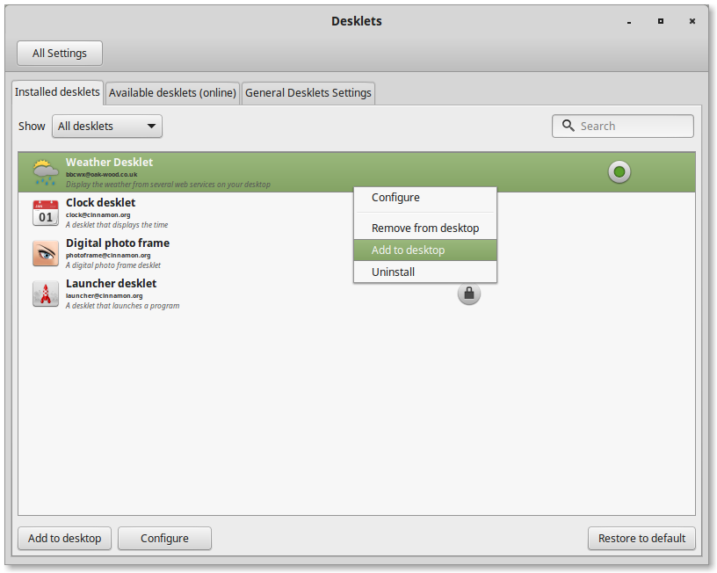
Finally, click 'Add to desktop'
Right-click 'Weather Desklet' again...
That's it! Check your desktop!

Slide 55
Let's go back to System Settings...
2. Click on System Settings
1. Click on Menu

Slide 56
Let's play a bit with
Hot Corners...

Slide 57
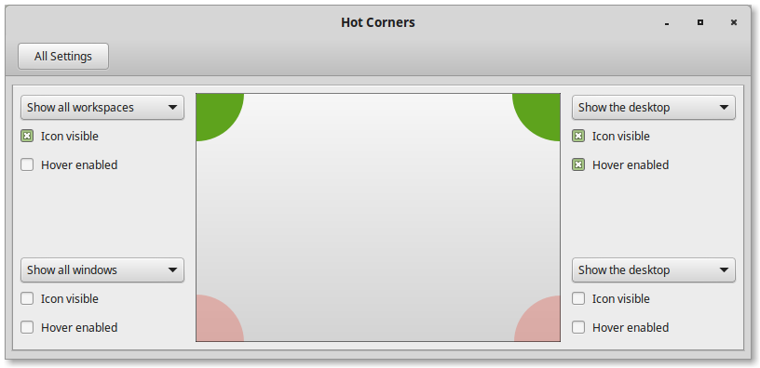

Hot Corners lets you do something when you put your mouse in the corner of your screen.
These shaded areas represent the corners of your screen.
These drop-downs tell your computer to do something when your mouse goes into that corner.
'Icon Visible' shows this symbol in the corner.
If you click on the symbol, the action will happen.

Slide 58
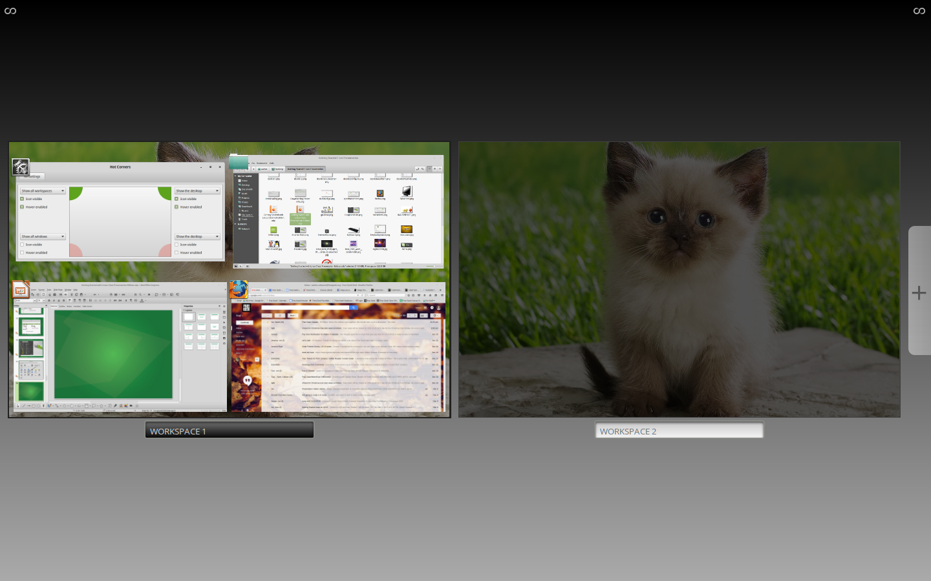
'Show all workspaces' allow you to quickly jump from project to project.

Slide 59
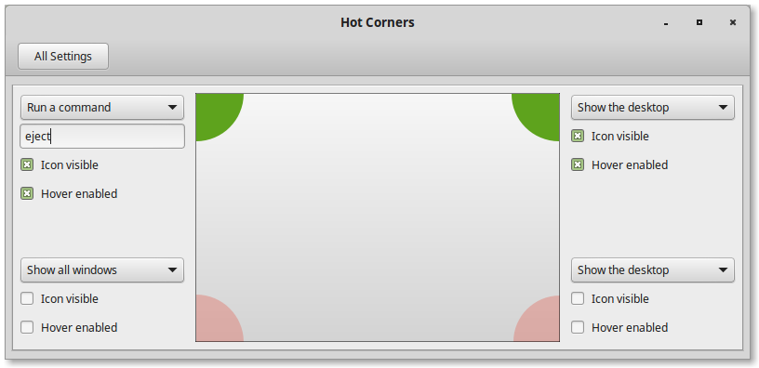
Now, let's try something fun!
First, set the drop-down menu to 'Run a command.'
Next, type 'eject' in the space.
Click the 'Icon visible' checkbox to show the symbol.
Now, click the symbol in the top-left corner...
Hot Corners is a useful tool if you like to work on multiple projects simultaneously.

Slide 60
Let's go back to System Settings...
2. Click on System Settings
1. Click on Menu

Slide 61
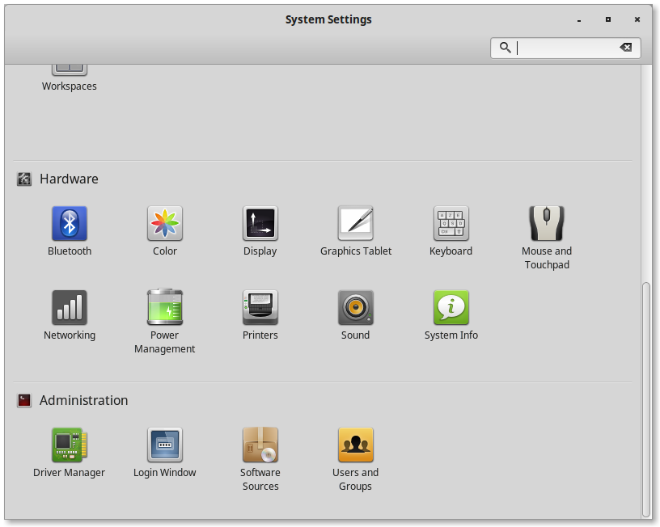
Use the scroll bar to scroll down...
Click on System Info

Slide 62
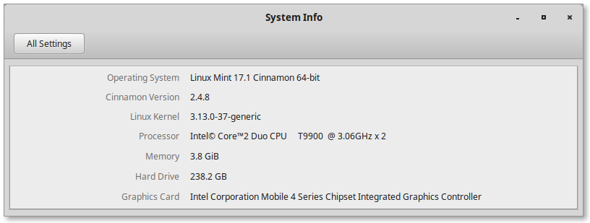
Here you can see the properties of your operating system and your hardware.
Version of Linux
Processor Info
RAM info
Hard Drive Space
Graphics Card (if any)

Slide 63
One last time...
2. Click on System Settings
1. Click on Menu

Slide 64
Use the scroll bar to scroll down...
Click on Users and Groups

Slide 65
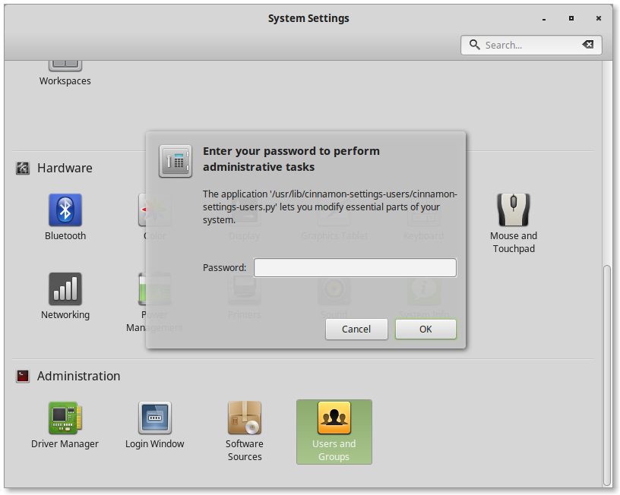
Enter your password...

Slide 66
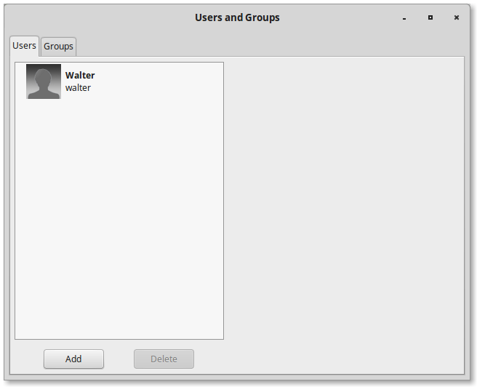
This area shows every user on this computer.
Click on your user.

Slide 67
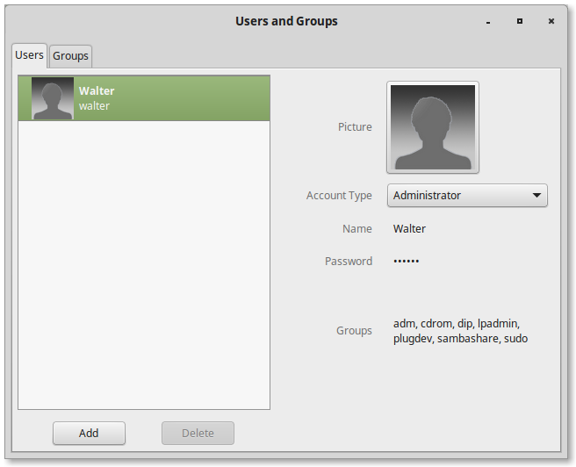
Here are the details about your account:
Your picture, your account type, your name, password, and groups.
You can change your password by clicking on the little dots.
Now, let's add a new user. Click Add below...

Slide 68
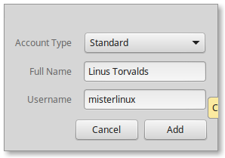
Leave account type as 'Standard.'
Enter the user's real name.
Enter the user's preferred username.
Then, click 'Add.'

Slide 69
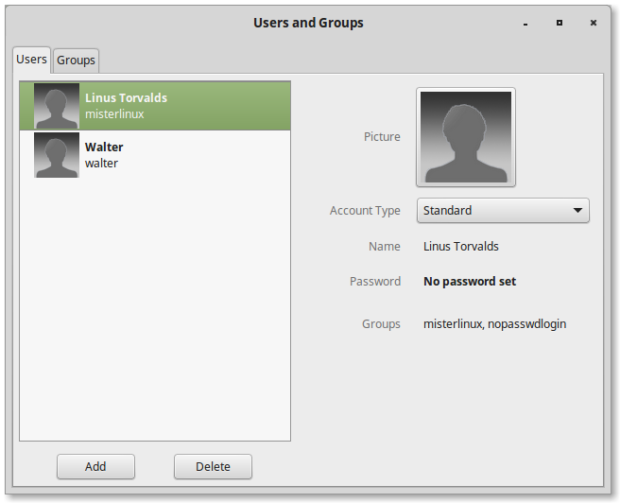
Your new user should be here now!
You can add a password for your new user here.

Slide 70

Enter and confirm your new user's password.
Click 'Show Password' in case you want to see what you're writing.

Slide 71

But what a boring picture right?
Let's choose a new user portrait.
Click on the silhouette image.

Slide 72

Now you can choose one of these pictures for your user.
But you can also download a picture for yourself from the Internet. Cam you remember how?

Slide 73
Let's take a deeper look into our Menu...
2. Hover over 'Accessories.'
1. Click on Menu

Slide 74

Accessories
Virtual calculator, can be set to arithmetic, scientific, or financial.
Capture and save a picture of anything on your screen.
Very useful tool for programming or troubleshooting your computer.

Slide 75

Graphics
3D-modeling program (free to download through Software Manager)
Linux Photoshop-equivalent program. Use it to edit photos!
Photo and image manager. Use it to view your photos!
Linux Graphic design program. Also free to download through Software Manager.

Slide 76

Internet
Firefox – your open-source web browser!
HexChat – an IRC chat program.
Internet Messenger. Can be used with AIM, GoogleHangouts, ICQ, etc...
Email management client, similar to Microsoft Outlook.

Slide 77

Office
Microsoft Excel equivalent.
Microsoft PowerPoint equivalent.
Microsoft Office equivalent.

Slide 78

Setting Office to save files as .doc files
Click on Tools
Click on Options...

Slide 79

Next to 'Always Save As:' open the menu and select Microsoft Word 97/2000/XP/2003
Click the small triangle next to Load/Save
Select General
You can make similar changes for Calc/Draw/Impress...

Slide 80

Sound & Video
Play online radio and listen to your music collection.
Burn copies of CDs and DVDs.
Take pictures, record or stream video (requires webcam).
General purpose video player, can play just about any file!

Slide 81

Searching for Files
Search for any file or program on your system by a specific name.
Find your saved documents and downloaded files here.
See any recently viewed or modified files. Useful to find something you were just working on.

Slide 82
Let's check out the Software Manager!
2. Click on Software Manager.
1. Click on Menu

Slide 83

Let's check out the Software Manager!
Now enter your password.

Slide 84

Software Manager
Click on Internet.

Slide 85
Free Geek Survey
Go to tinyurl.com/fgfeedback
Fill out our brief survey
  Help us make our classes and offerings even better!

Slide 86

www.freegeek.org/#learn
Drag the globe symbol onto your Bookmark bar!
Bookmark us!

Slide 87

Bookmark us!
www.freegeek.org/about/techsupport/
Drag the globe symbol onto your Bookmark bar!

Slide 88

Tech Support Policy:
Your computer will be fully supported for one year, as long as:
- The system has not been modified by anyone (except Free Geek).
- The system has been used as intended since adoption.
- The system has been used by you or another person who has taken the adoption class.
Tech Support can be reached at 503-232-9350 ext.6
Tuesday through Saturday, 12PM ~ 6PM.

Slide 89

Questions

Slide 90
Check out some of our other classes:
Additional resources:
Linuxmint.org
Distrowatch.com
PLUG – Portland Linux Users Group
Command Line
Social Media for Organizations
Linux Open Questions
GIMP & Inkscape
Do-it-Yourself CNC Mill
Anatomy of a Hack
And more...
Sign up at the Front Desk!

Slide 91

Thank you for coming!

